Slide 1
CS266 Software Reverse Engineering (SRE) Reversing and Patching Java Bytecode
Teodoro (Ted) Cipresso
Senior Software Engineer, IBM
SRE Guest Lecture
The information in this presentation is taken from the thesis “Software reverse engineering education” available at http://scholarworks.sjsu.edu/etd_theses/3734/ where all citations can be found.

Slide 2
Reversing and Patching Java Bytecode
Good-quality Java source can often be generated from Java bytecode with little difficulty due to certain characteristics of bytecode:
Platform-independent (consistent) instruction set and layout/format.
Very rich, well-structured metadata about Classes, Methods, and Variables:
names and datatypes (e.g., String personName, Map personRecord).
Method signatures (includes Constructors).
Generating HLL source (e.g., C/C++) from machine code is challenging due to high variation in the output of compilers on different platforms and unavoidable loss of information that occurs when compiling a HLL down to machine code.
Note: Symbolic information may be included in machine code when specifying a compiler’s “debug” option (e.g., -g, -debug, TEST).

Slide 3
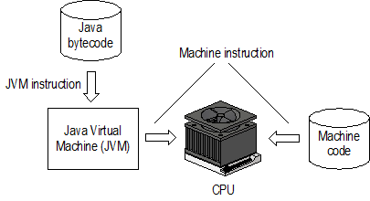
Reversing and Patching Java Bytecode (cont’d)
The following diagram illustrates the difference in how Java bytecode and machine code are processed during execution:

Slide 4
Reversing and Patching Java Bytecode (cont’d)
The following formal definitions of machine code and Java bytecode apply:
Machine code: “Machine code or machine language is a system of instructions and data executed directly by a computer's central processing unit” [14]. Machine code contains the platform-specific machine instructions to execute on the target processor.
Java bytecode: “Bytecode is the intermediate representation of Java programs just as assembler is the intermediate representation of C or C++ programs” [15]. Java bytecode contains platform-independent instructions that are translated to platform-specific instructions by a Java Virtual Machine.

Slide 5
Reversing and Patching Java Bytecode (cont’d)
Machine code is stored in files with varying extensions (*.exe, *.dll, *.so,..,); extensions are dependent upon the operating system.
On the contrary…
Java bytecode is always stored in files that have a *.class extension.
The Java Language Specification allows at most one top-level public class to be defined per *.java source file and requires that the bytecode be stored in a file with whose name matches the pattern TopLevelClassName.class.
Collections of Java classes, such as those for an application or class library, are stored together in an archive file with a *.jar extension.

Slide 6
Reversing and Patching Java Bytecode Decompiling and Disassembling Java Bytecode
Bytecode is stored in a binary format that is not human-readable and therefore must be “disassembled” in order to be read.
Oracle’s Java Development Toolkit (JDK) comes with javap, a command-line tool for “disassembling” Java bytecode.
To say that javap disassembles bytecode is a misnomer because the output of javap is unstructured text which cannot be compiled back to bytecode.
The assumption is you already have the *.class file.
The output of javap is nonetheless useful as a debugging and performance tuning aid since one can see which JVM instructions are generated from high-level Java language statements.

Slide 7
Reversing and Patching Java Bytecode Decompiling and Disassembling Java Bytecode
javap demo

Slide 8
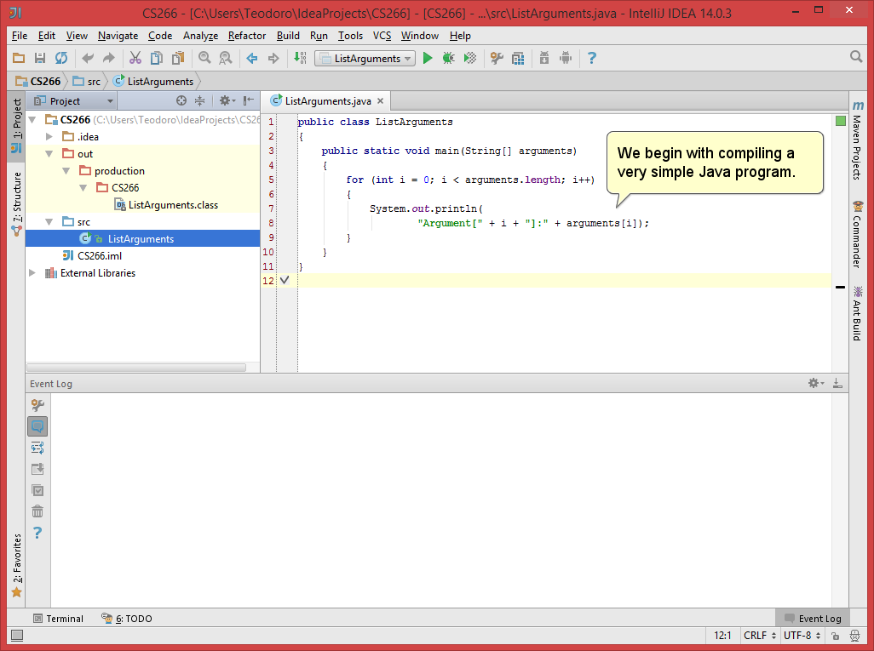

Slide 10
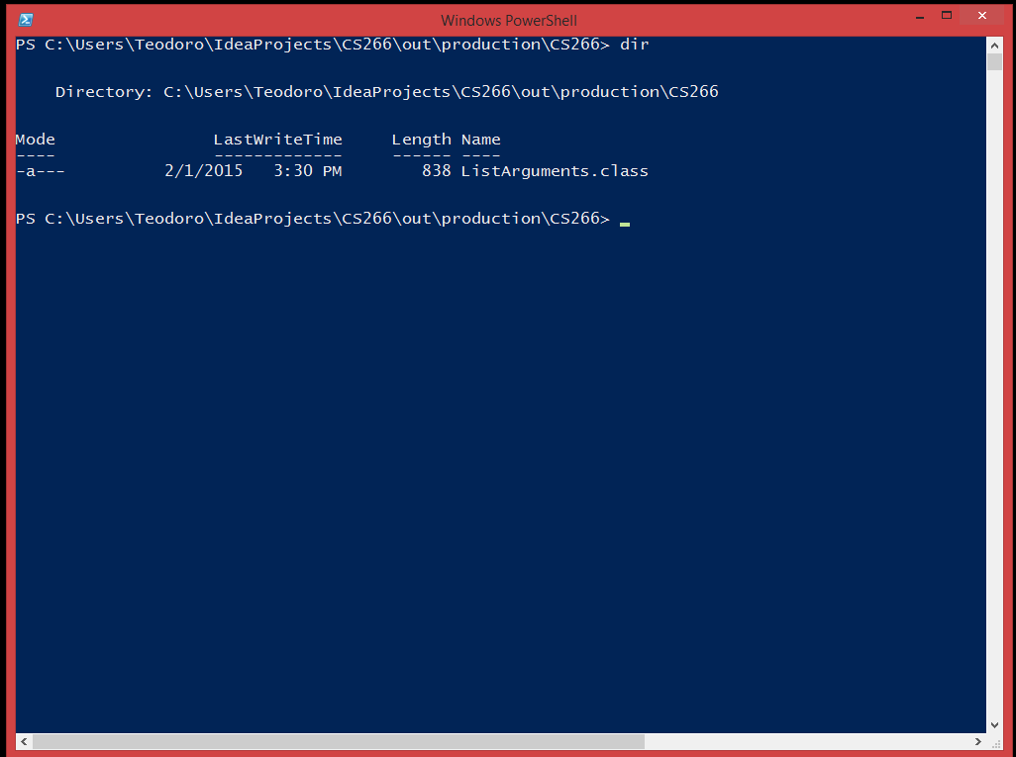

Slide 11
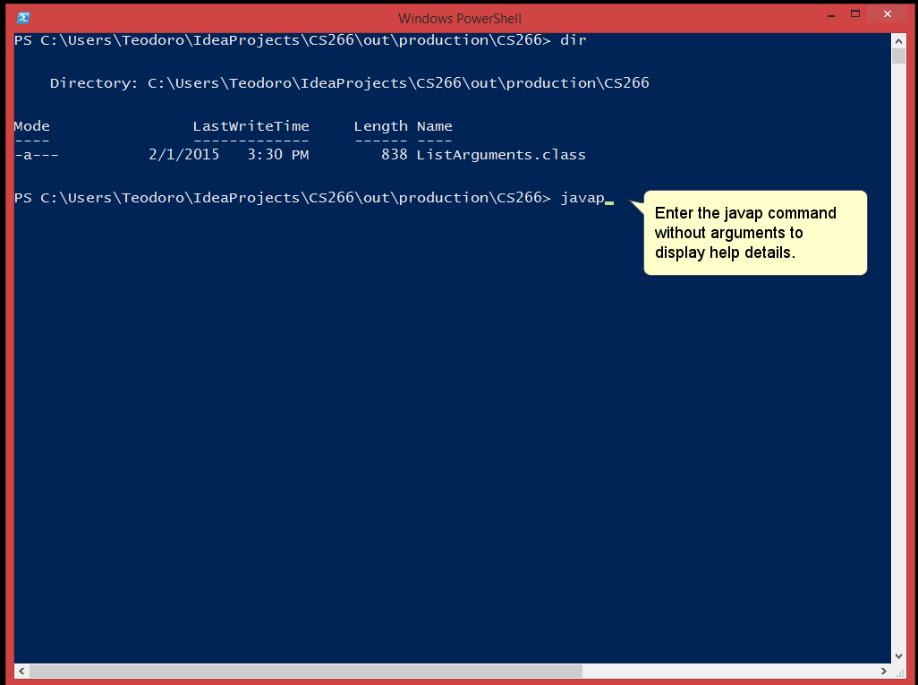

Slide 12
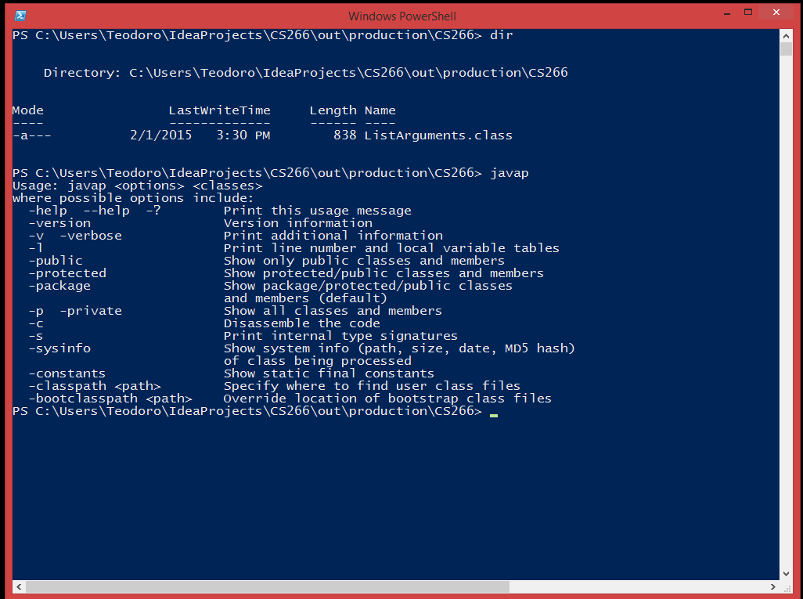

Slide 13
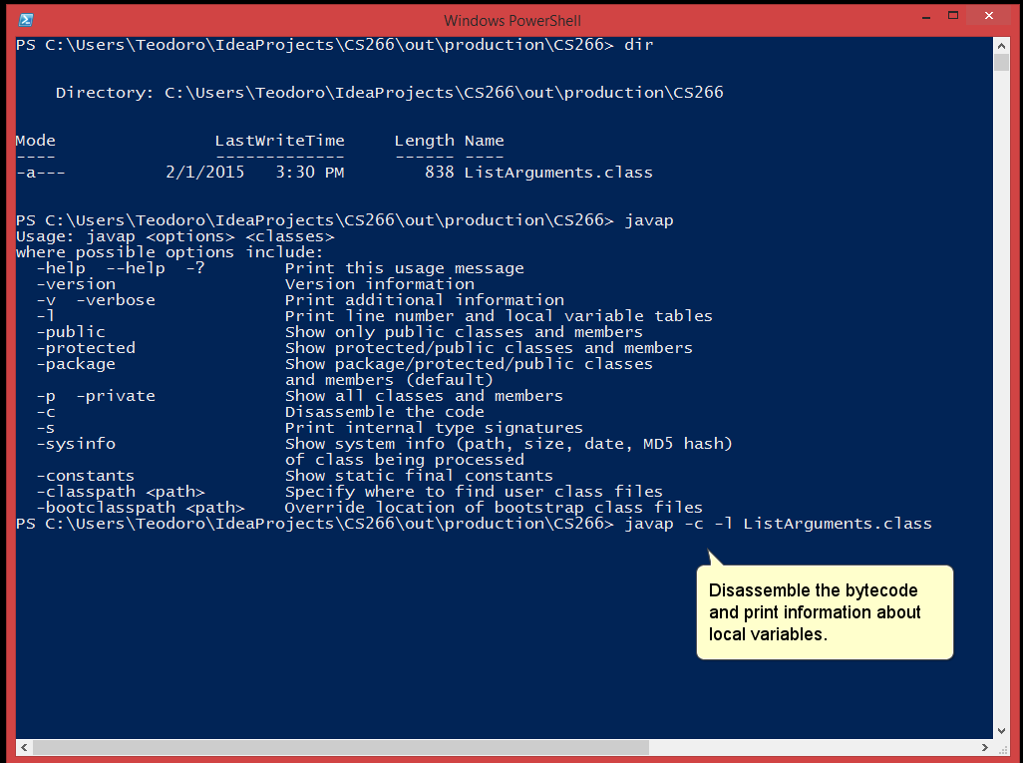

Slide 14
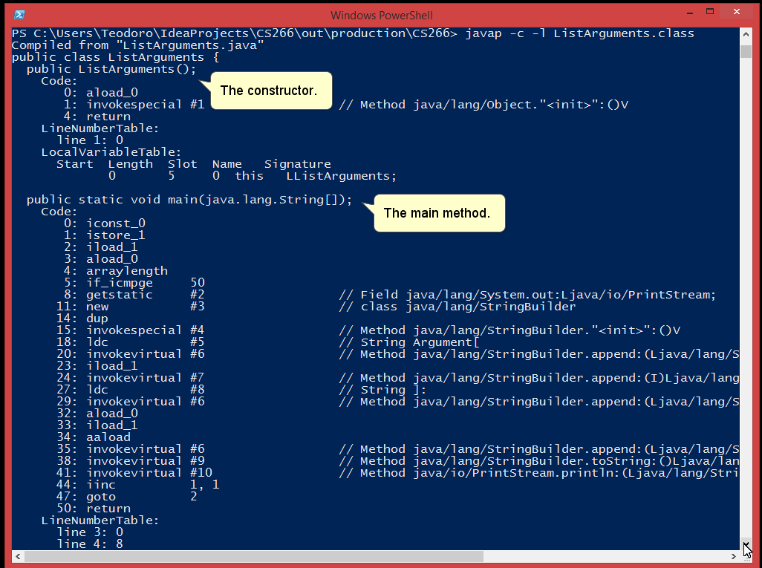

Slide 15
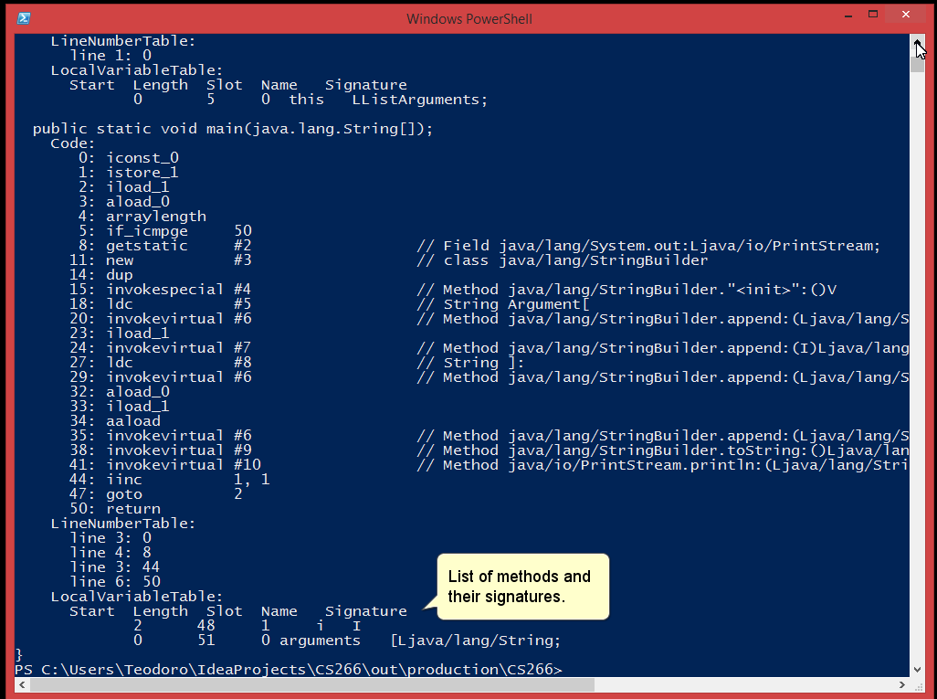

Slide 16
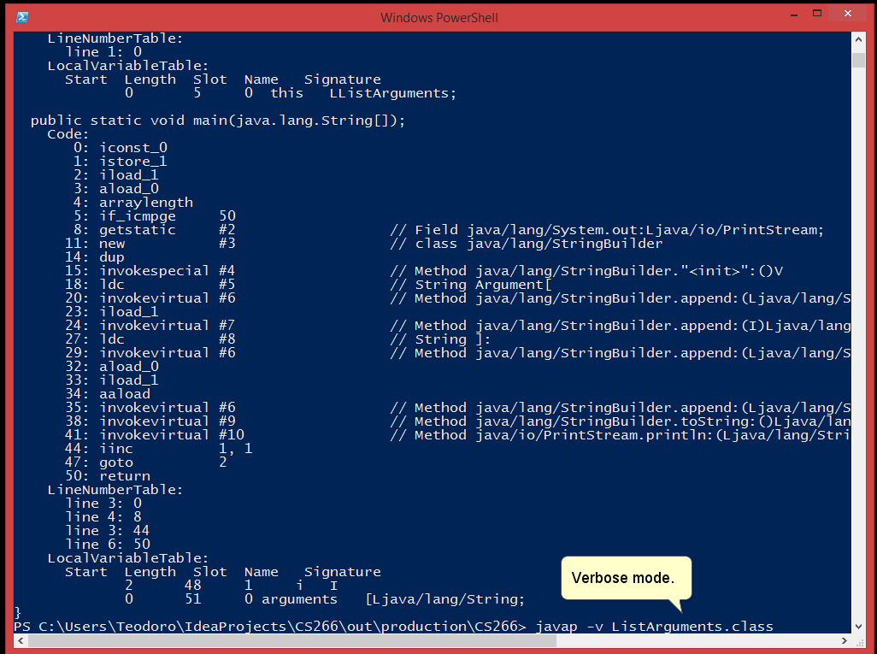

Slide 17
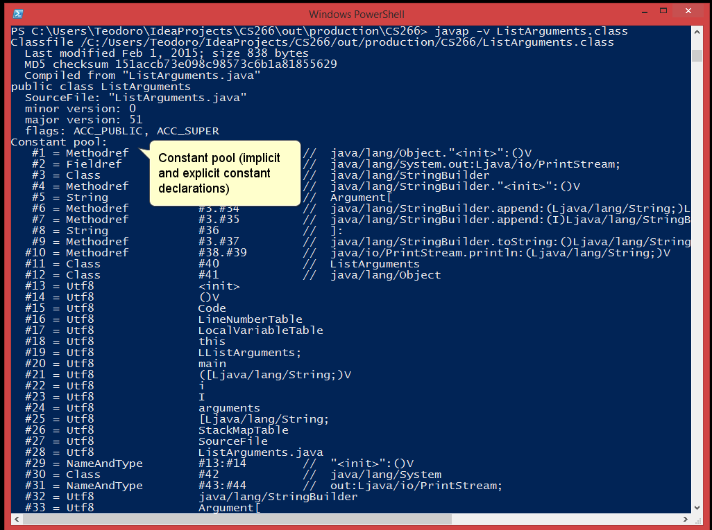

Slide 18
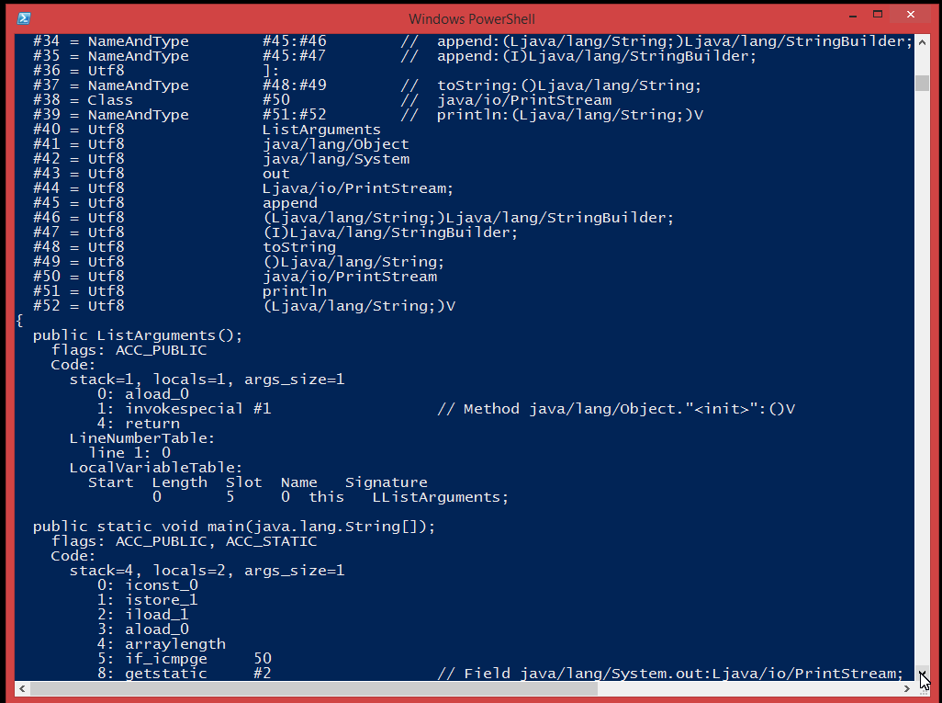

Slide 19
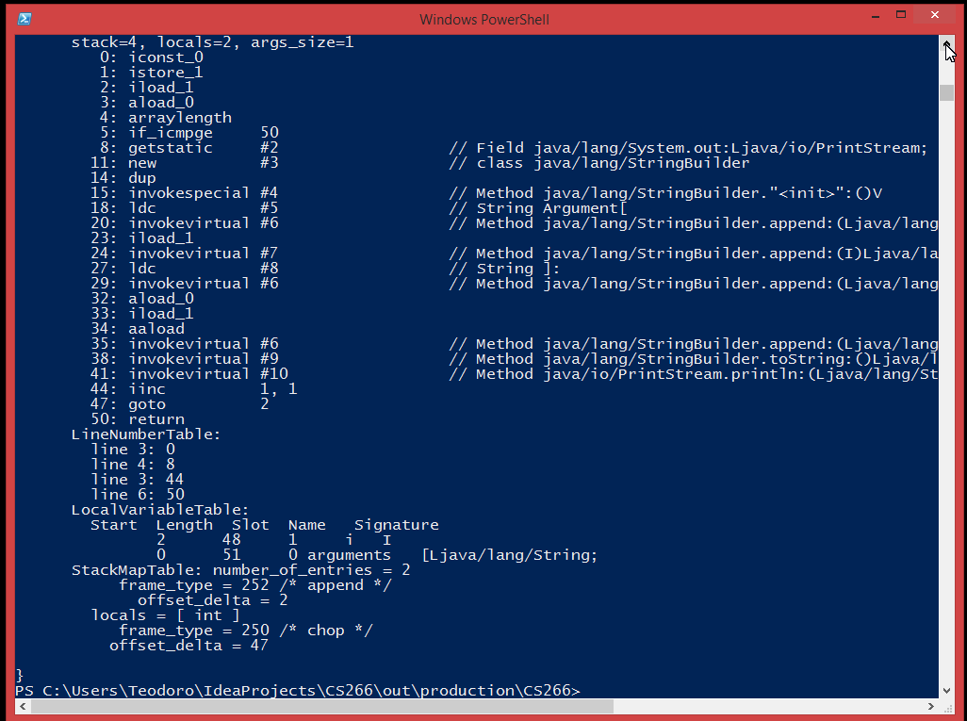

Slide 20
Reversing and Patching Java Bytecode Decompiling and Disassembling Java Bytecode
The result of disassembling Java bytecode is a pseudo-assembly language, a language that cannot be compiled or assembled but serves to provide a more abstract, readable representation of the bytecode.
While it may seem possible to use a hex editor directly modify Java bytecode in a *.class file, this is similar in difficulty to editing machine code in a hex editor.
However, libraries exist for deserializing and serializing bytecode using in-memory Java object models. This allows programmatic modification.
Decompiling then recompiling Java bytecode after making modifications is perhaps the most straightforward way to reverse and patch Java applications.

Slide 21
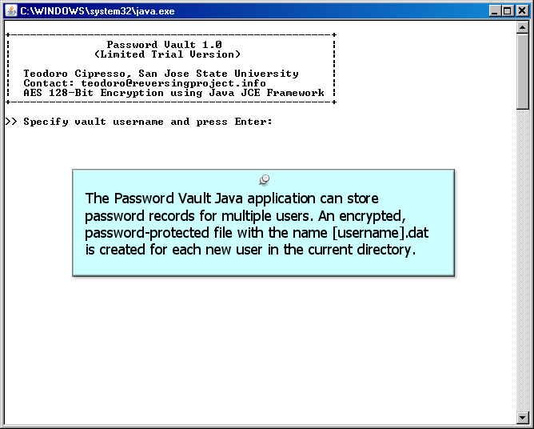
Reversing and Patching Java Bytecode Java Bytecode Reversing and Patching Exercise

Slide 22
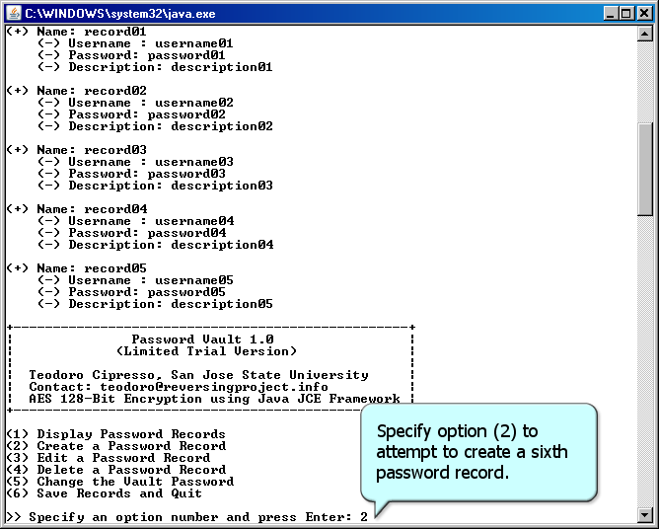
Reversing and Patching Java Bytecode Java Bytecode Reversing and Patching Exercise
PasswordVault.jar

Slide 23
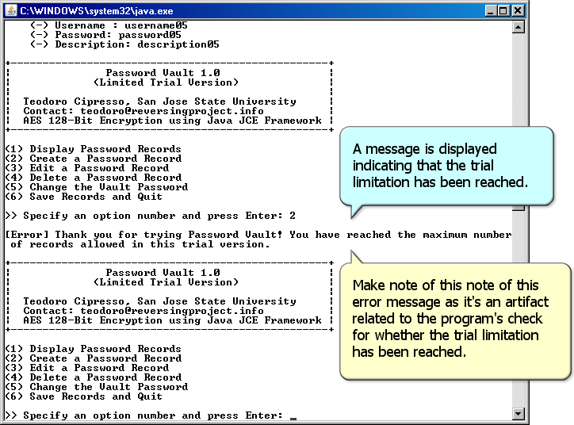
Reversing and Patching Java Bytecode Java Bytecode Reversing and Patching Exercise
PasswordVault.jar

Slide 24
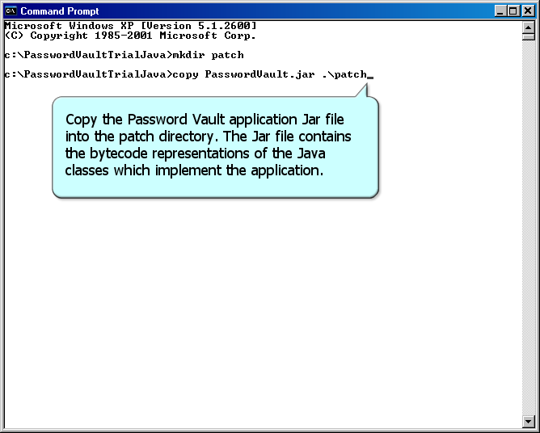
Reversing and Patching Java Bytecode Java Bytecode Reversing and Patching Exercise
PasswordVault.jar

Slide 25
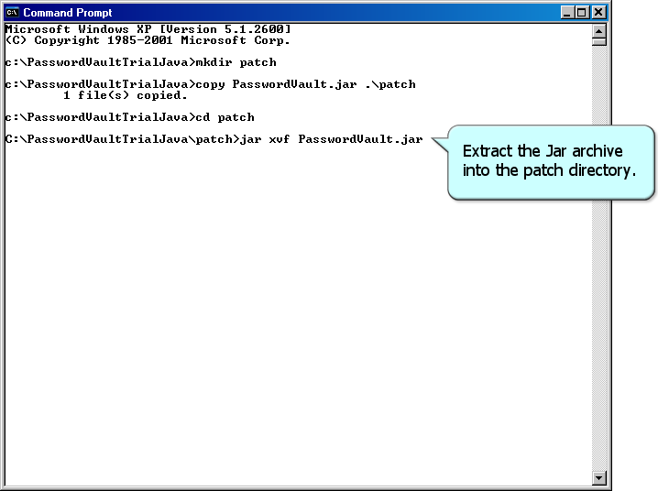
Reversing and Patching Java Bytecode Java Bytecode Reversing and Patching Exercise
PasswordVault.jar

Slide 26
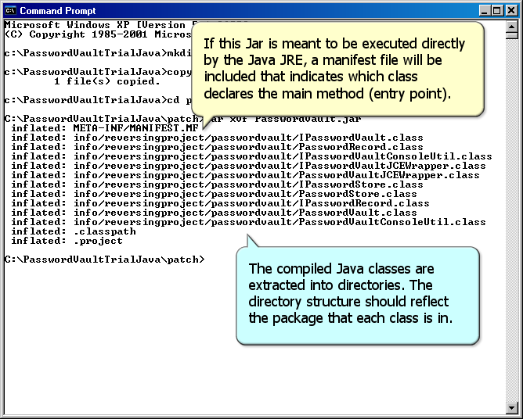
Reversing and Patching Java Bytecode Java Bytecode Reversing and Patching Exercise

Slide 27
Reversing and Patching Java Bytecode Java Bytecode Reversing and Patching Exercise
FrontEndPlusV1andV2.zip

Slide 28
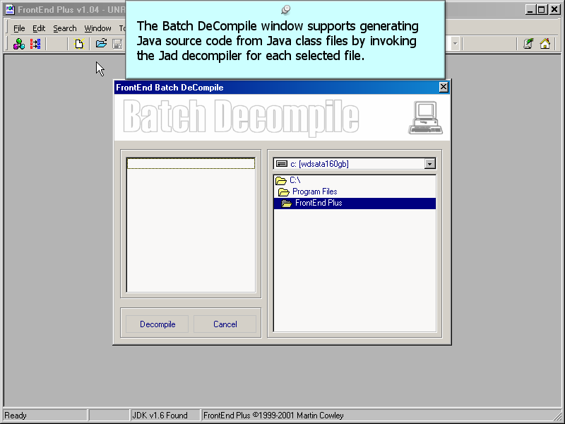
Reversing and Patching Java Bytecode Java Bytecode Reversing and Patching Exercise
FrontEndPlusV1andV2.zip

Slide 29
Reversing and Patching Java Bytecode Java Bytecode Reversing and Patching Exercise
FrontEndPlusV1andV2.zip

Slide 30
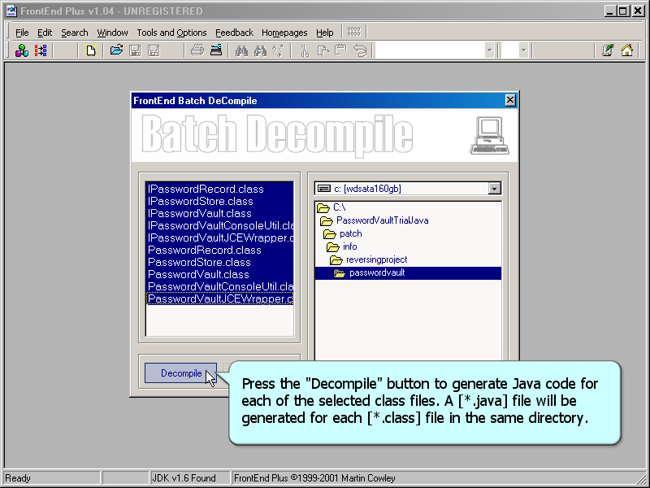
Reversing and Patching Java Bytecode Java Bytecode Reversing and Patching Exercise
FrontEndPlusV1andV2.zip

Slide 31
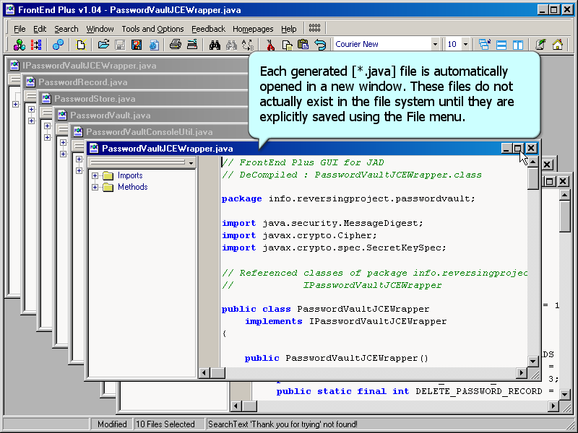
Reversing and Patching Java Bytecode Java Bytecode Reversing and Patching Exercise
FrontEndPlusV1andV2.zip

Slide 32
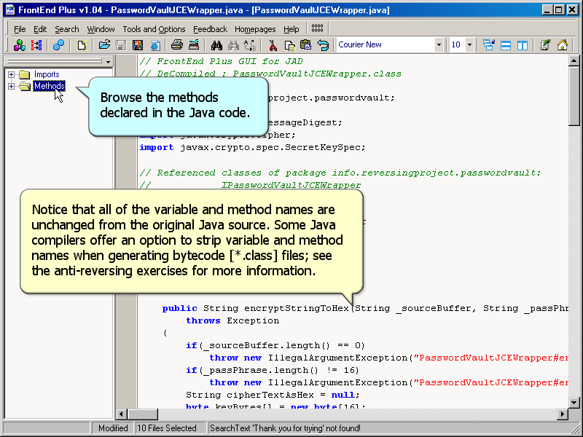
Reversing and Patching Java Bytecode Java Bytecode Reversing and Patching Exercise
FrontEndPlusV1andV2.zip

Slide 33
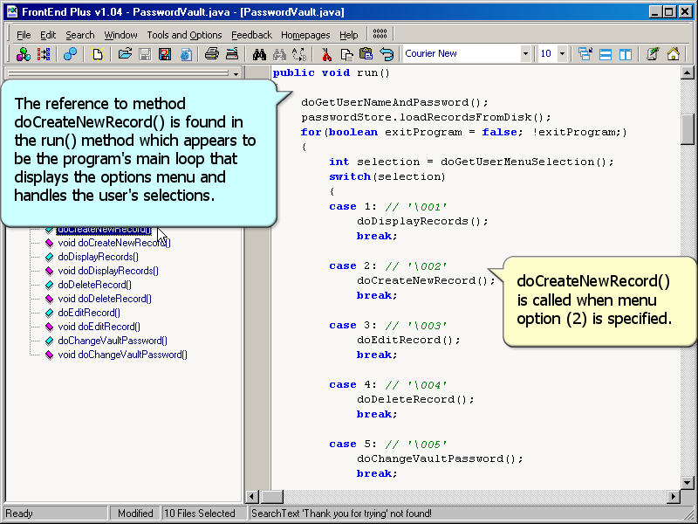
Reversing and Patching Java Bytecode Java Bytecode Reversing and Patching Exercise
FrontEndPlusV1andV2.zip

Slide 34
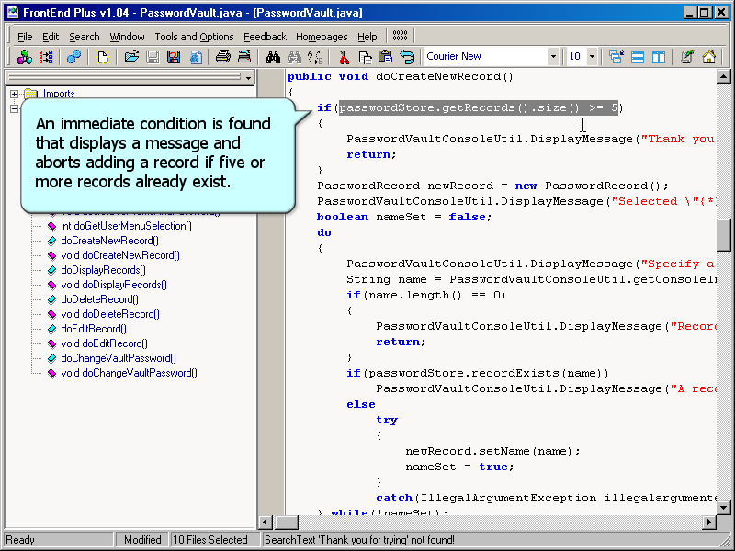
Reversing and Patching Java Bytecode Java Bytecode Reversing and Patching Exercise
FrontEndPlusV1andV2.zip

Slide 35
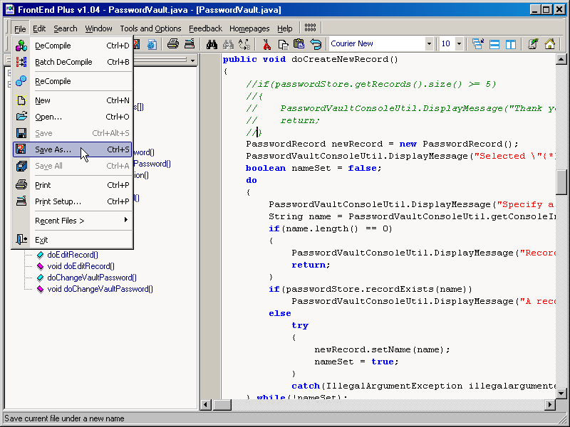
Reversing and Patching Java Bytecode Java Bytecode Reversing and Patching Exercise
FrontEndPlusV1andV2.zip

Slide 36
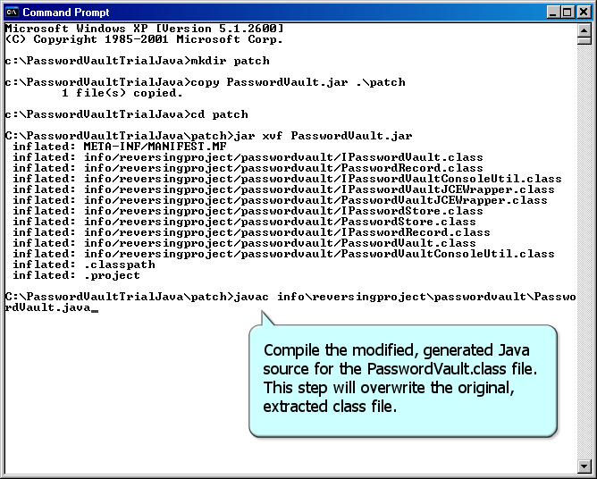
Reversing and Patching Java Bytecode Java Bytecode Reversing and Patching Exercise
PasswordVault.jar

Slide 37
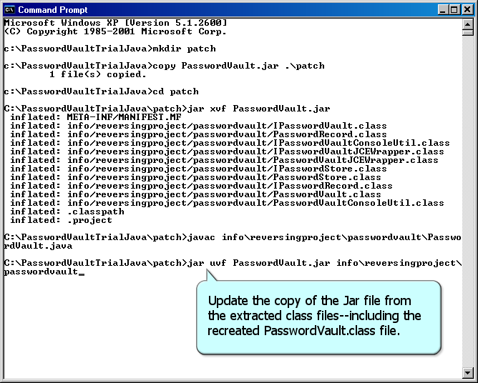
Reversing and Patching Java Bytecode Java Bytecode Reversing and Patching Exercise
PasswordVault.jar

Slide 38
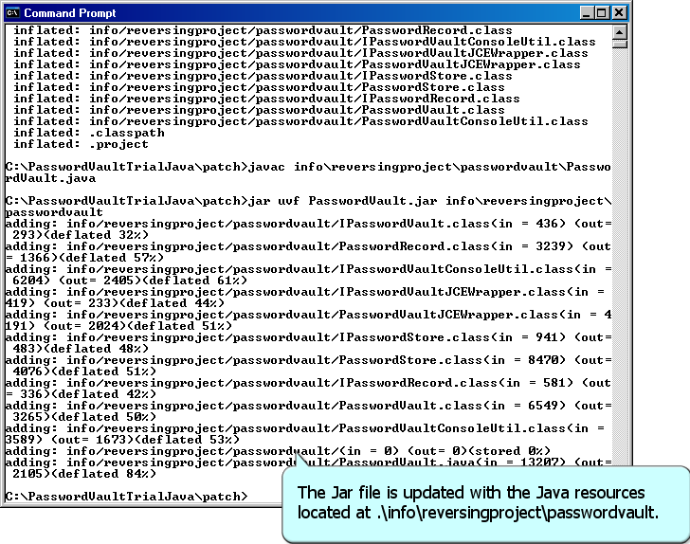
Reversing and Patching Java Bytecode Java Bytecode Reversing and Patching Exercise
PasswordVault.jar

Slide 39
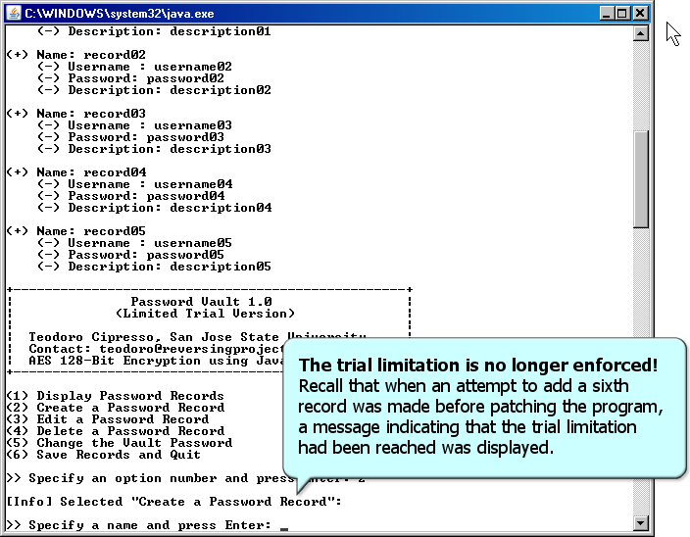
Reversing and Patching Java Bytecode Java Bytecode Reversing and Patching Exercise
PasswordVault.jar

Slide 40
Reversing and Patching Java Bytecode Byte Code Engineering Library (BCEL)
BCEL provides a convenient way to analyze, create, and manipulate Java Bytecode (Java *.class files).
Perform static analysis, dynamically create or transform Java bytecode.
High level of abstraction of the Java class file format relieves the programmer from internal details of the Java class file format.
BCEL is used in projects such as compilers, optimizers, obfuscators, code generators and analysis tools.

Slide 41
Reversing and Patching Java Bytecode Byte Code Engineering Library (BCEL) API
The BCEL API abstracts the Java Virtual Machine and reading and writing binary Java class files. The API consists mainly of three parts:
A package that may be used to read and write class files from or to a file. The main data structure is JavaClass.
Usage: analyze Java classes without having the source files at hand.
A package to dynamically generate or modify JavaClass or Method objects.
Usage: insert analysis code, strip information, implement a code generator back-end of a Java compiler.
Various code examples and utilities such as a class file viewer.

Slide 42
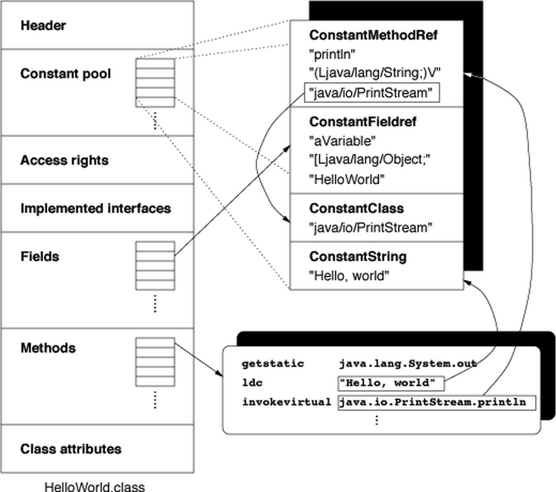
Java Class File Format
[BCEL Manual]

Slide 43
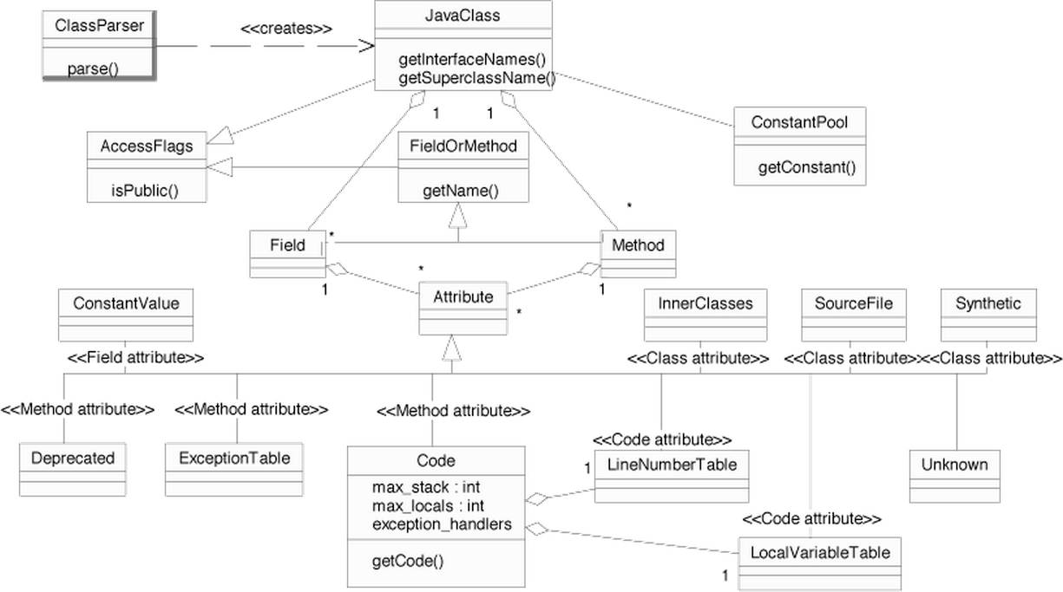
JavaClass
[BCEL Manual]

Slide 44
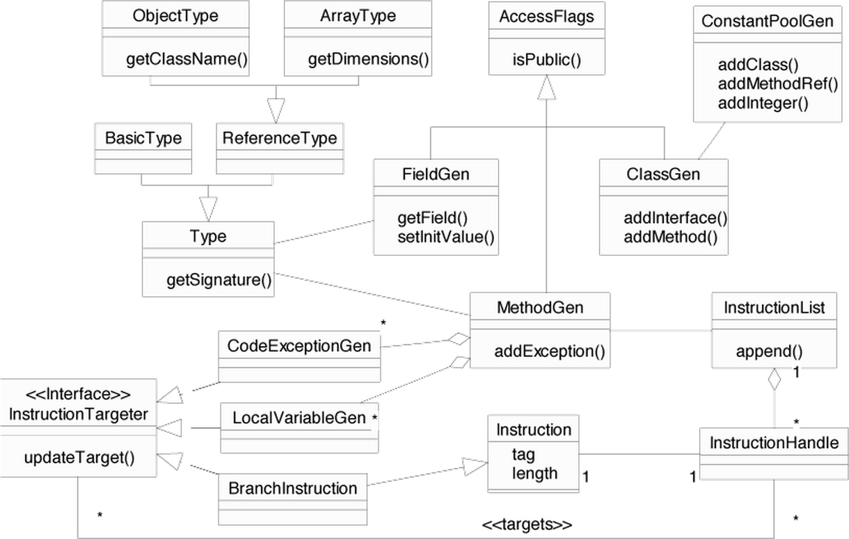
ClassGen
[BCEL Manual]

Slide 45
Reversing and Patching Java Bytecode Byte Code Engineering Library (BCEL) API
BCEL demo

Slide 46
End

