Slide 1
CS266 Software Reverse Engineering (SRE) Applying Anti-Reversing Techniques to Java Bytecode
Teodoro (Ted) Cipresso
Senior Software Engineer, IBM
SRE Guest Lecture
The information in this presentation is taken from the thesis “Software reverse engineering education” available at http://scholarworks.sjsu.edu/etd_theses/3734/ where all citations can be found.

Slide 2
Applying Anti-Reversing Techniques to Java Bytecode Introduction and Motivation for Anti-Reversing
If Java bytecode is not protected through obfuscation it’s straightforward for a reverser to decompile the bytecode, make changes, and recompile.
If our software sells for money, then it’s natural to offer a trial version.
Trial versions employ guards to ultimately earn your business:
Time-bomb: stops working after n days.
Usage limit: stops working after n minutes or n operations.
Crippleware: Critical functionality is disabled (e.g, can’t save you work).
This is hard to get right without annoying a potential customer.

Slide 3
Applying Anti-Reversing Techniques to Java Bytecode Introduction and Motivation for Anti-Reversing
Applying anti-reversing techniques to Java bytecode (or binaries in general) can prevent a reverser from:
Removing trialware guards in software (types on previous slide).
Recovering algorithms that make the software valuable.
While anti-reversing techniques cannot completely prevent software from being reversed, they act as a deterrent by increasing the challenge for the reverser.
[5] states “It is never possible to entirely prevent reversing” and “What is possible is to hinder and obstruct reversers by wearing them out and making the process so slow and painful that they give up.”

Slide 4
Applying Anti-Reversing Techniques to Java Bytecode Introduction and Motivation for Anti-Reversing
Apply anti-reversing techniques to source code, machine code, or bytecode can have adverse effects on a program's size, efficiency, and maintainability.
Therefore, it’s important to evaluate whether a particular program warrants the cost of protecting it.
Anti-reversing techniques are meant to be applied post-production, after the coding for an application is complete and tested.
These techniques obscure data and logic and therefore are difficult to implement while also working on the functionality of the application.
Even worse than the general confusion of interleaving anti-reversing techniques with regular coding is the possibility of creating a dependency between the actual application logic and the anti-reversing techniques used.

Slide 5
Applying Anti-Reversing Techniques to Java Bytecode Basic Anti-Reversing Techniques
Eliminating Symbolic Information: Render unrecognizable, all symbolic information in machine code or bytecode because such information can be quite useful to a reverse engineer.
Obfuscating the Program: Includes removing symbolic information but goes much further. Care must be taken with the following techniques to ensure that the original program functionality remains intact.
Modify the layout of a program (move things around).
Introducing confusing non-essential logic or control flow.
Storing data in difficult to interpret organizations or formats.
Obfuscate data structures, encrypt strings etc..

Slide 6
Applying Anti-Reversing Techniques to Java Bytecode Basic Anti-Reversing Techniques
Embedding Antidebugger Code: Live analysis is how most reversers accomplish their objective. Therefore it is common for developers to implement guards against binary debuggers.
Live analysis of machine code is accomplished using an interactive debugger-disassembler where you attach to a running programming and step instructions to observe the program at points of interest.
Static analysis of machine code is usually carried out using a disassembler and heuristic algorithms that attempt to understand the structure of the program.
Interactive debugging of Java bytecode can be accomplished using debugger interfaces implemented by the JVM per the Java Platform Debugger Architecture (JPDA).

Slide 7
Applying Anti-Reversing Techniques to Java Bytecode Java Bytecode Anti-Reversing Considerations
While it is most often the case that we cannot recover the original Java source code from the bytecode, the results will be functionally equivalent.
When new features are added to the Java language, new bytecode instructions are not always added or needed. For example:
Support for generics in collections is implemented by carrying additional information (in the constants pool of the class) that describes the type of object a collection should contain.
This information can then be used at execution time by the JVM to validate the type of each object in the collection.

Slide 8
Applying Anti-Reversing Techniques to Java Bytecode Java Bytecode Anti-Reversing Considerations
The strategy of having newer Java language constructs result in compatible bytecode with optionally-utilized metadata provides the benefit of allowing legacy Java bytecode to run on newer JVMs.
If a decompiler doesn't know to look for the metadata, some information is lost. For example:
The fact that a program used generics would not be recovered and all collections would be of type Object (with cast statements of course).

Slide 9
Applying Anti-Reversing Techniques to Java Bytecode Java Bytecode Anti-Reversing Tools
Since Java bytecode is standardized there are many obfuscation tools available on the Internet which perform transformations directly on the Java bytecode instead of on the Java source code itself.
SandMark: A Tool for the Study of Software Protection Algorithms [27]
RetroGuard for Java Obfuscation [28] (defunct, CLI only)
ProGuard [29]
Zelix Klassmaster [26] (not free)
Extensive list of related or alternative tools

Slide 10
Applying Anti-Reversing Techniques to Java Bytecode Eliminating Symbolic Information
Variable, class, and method names, are all left intact when compiling Java source code to Java bytecode.
Oracle’s Java compiler javac provides an option to leave out debugging information in Java bytecode: specifying javac -g:none will exclude information on line numbers, the source file name, and local variables.
This option offers little to no help in fending off a reverser as none of the remaining variable names, methods names, and constants are obfuscated.
[26] states that a high-level of protection can be achieved for Java bytecode by applying three transformations: Name Obfuscation, String Encryption, and Flow Obfuscation.
There does not appear to be a free anti-reversing tool that can perform all three of these transformations to Java bytecode.

Slide 11
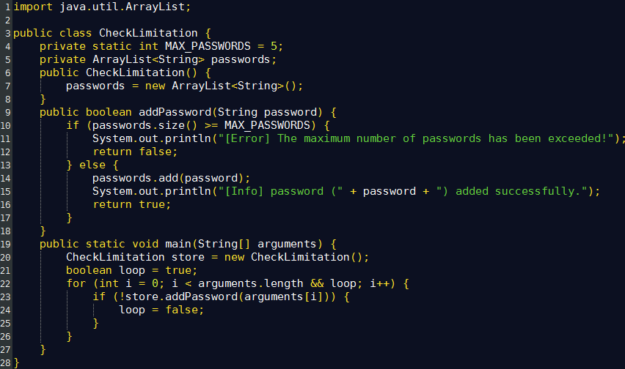
Applying Anti-Reversing Techniques to Java Bytecode Eliminating Symbolic Information

Slide 12
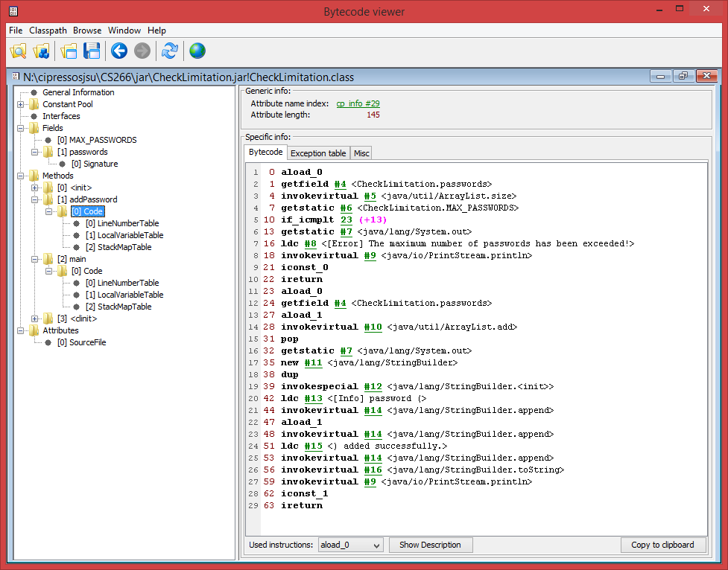
Applying Anti-Reversing Techniques to Java Bytecode Eliminating Symbolic Information

Slide 13
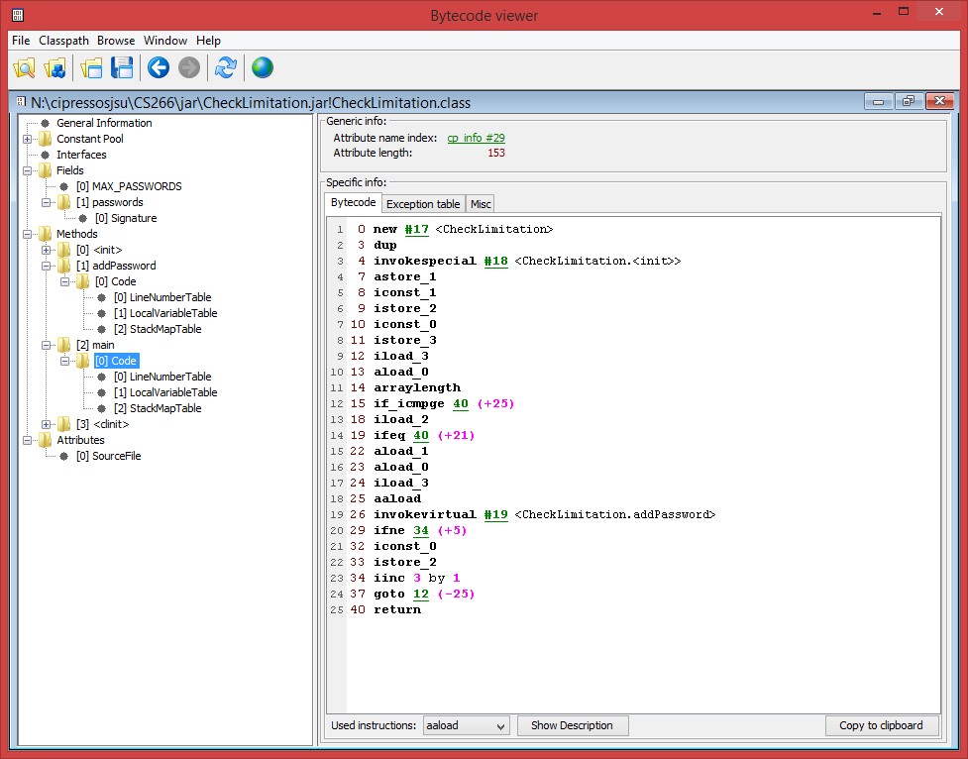
Applying Anti-Reversing Techniques to Java Bytecode Eliminating Symbolic Information

Slide 14
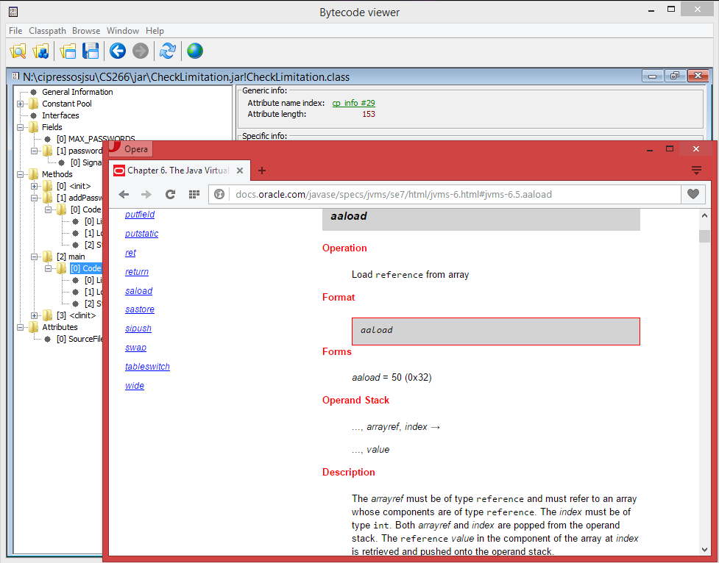
Applying Anti-Reversing Techniques to Java Bytecode Eliminating Symbolic Information

Slide 15
Applying Anti-Reversing Techniques to Java Bytecode Eliminating Symbolic Information

Slide 16
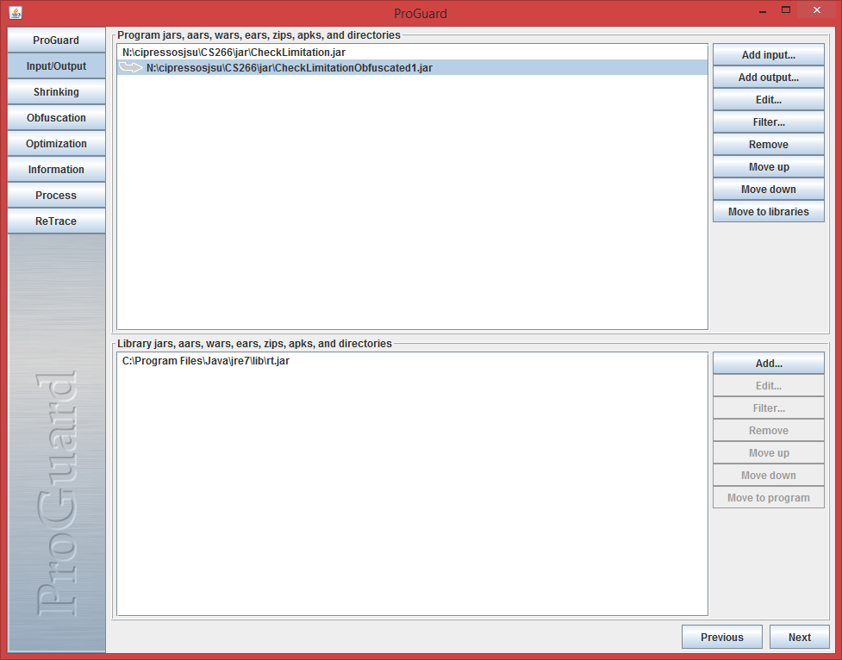
Applying Anti-Reversing Techniques to Java Bytecode Eliminating Symbolic Information

Slide 17
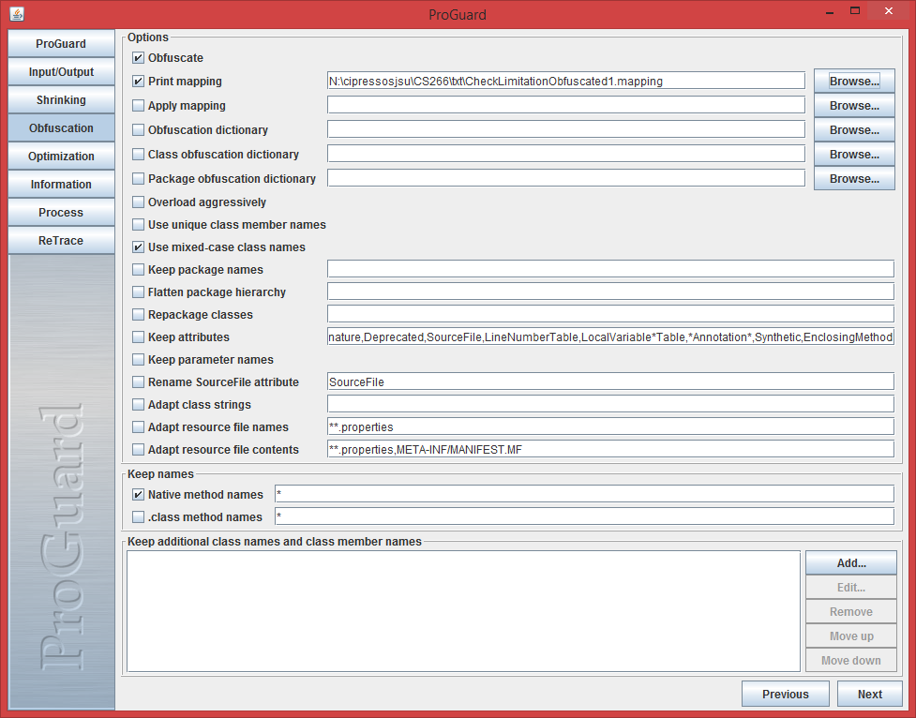
Applying Anti-Reversing Techniques to Java Bytecode Eliminating Symbolic Information

Slide 18
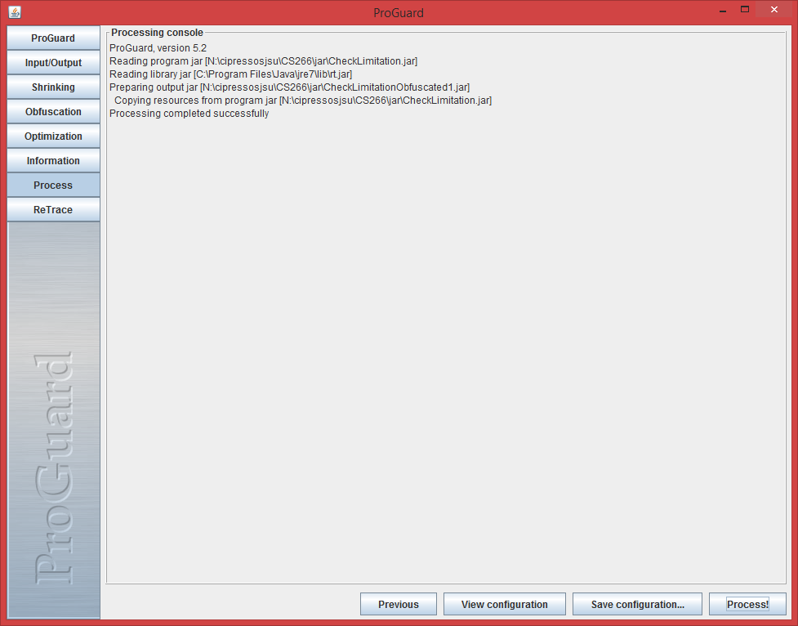
Applying Anti-Reversing Techniques to Java Bytecode Eliminating Symbolic Information

Slide 19
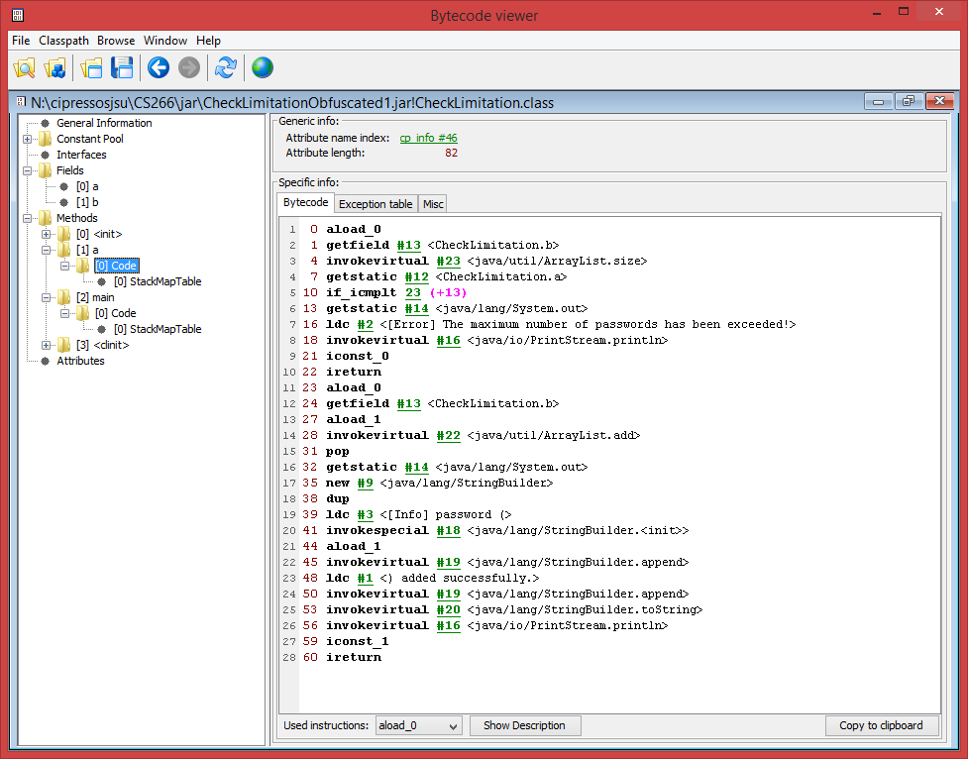
Applying Anti-Reversing Techniques to Java Bytecode Eliminating Symbolic Information

Slide 20
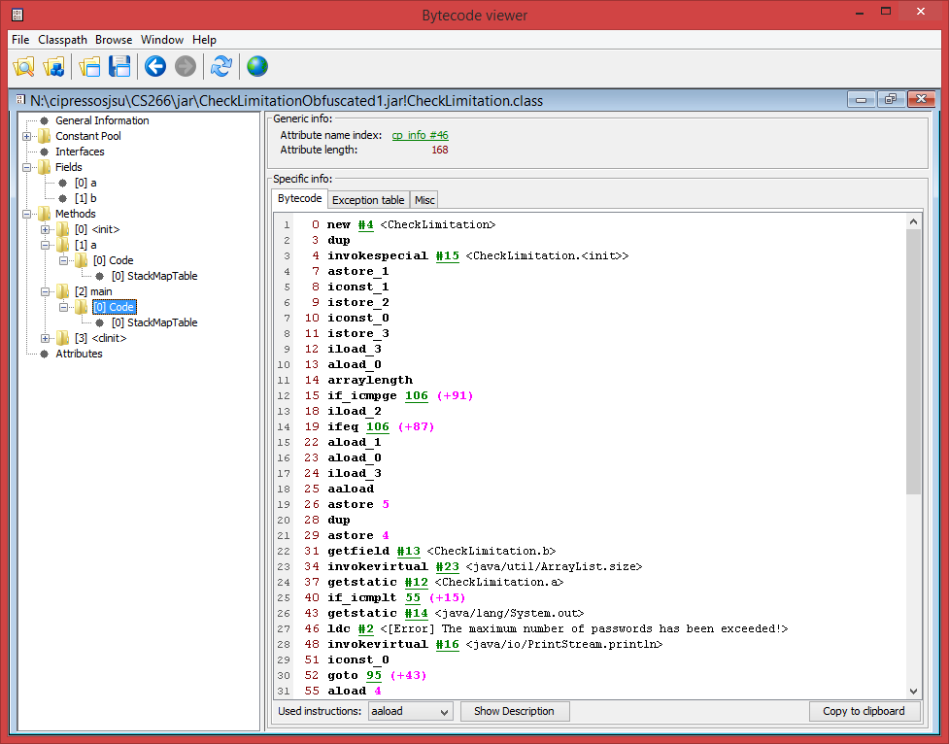
Applying Anti-Reversing Techniques to Java Bytecode Eliminating Symbolic Information

Slide 21
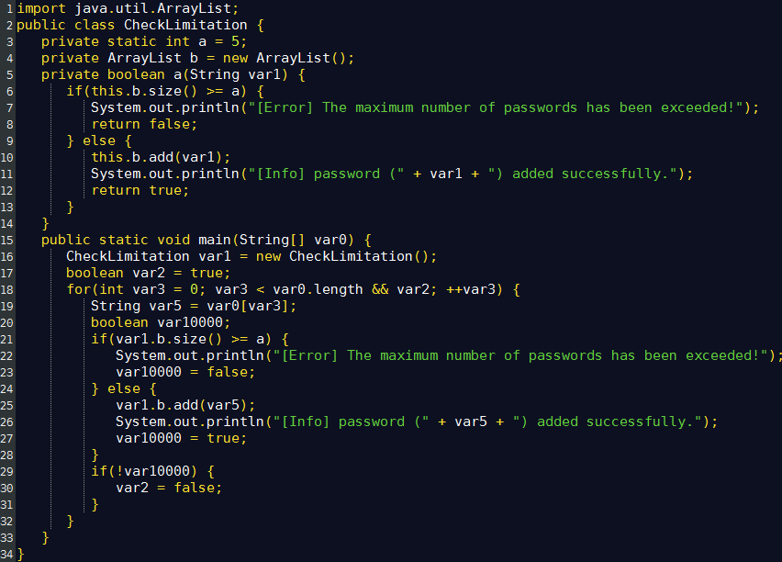
Applying Anti-Reversing Techniques to Java Bytecode Eliminating Symbolic Information

Slide 22
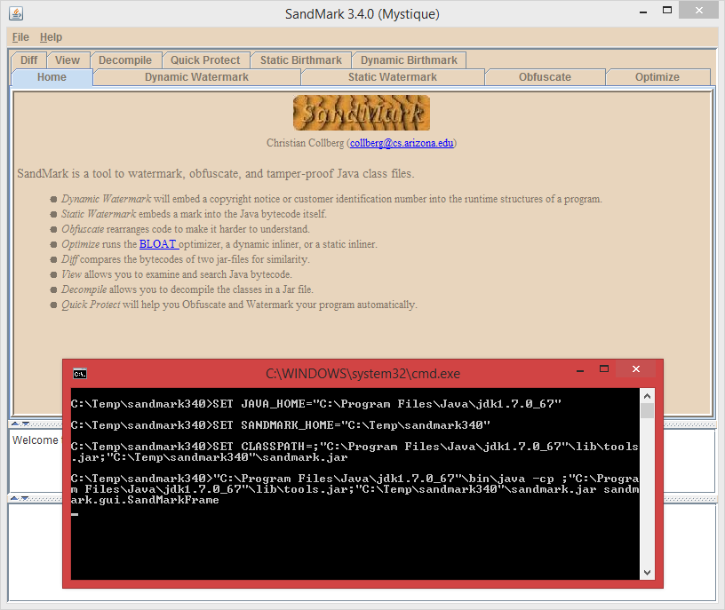
Applying Anti-Reversing Techniques to Java Bytecode Eliminating Symbolic Information

Slide 23
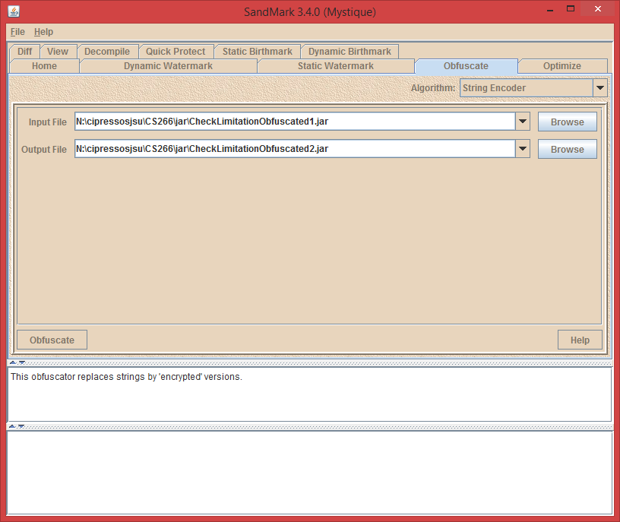
Applying Anti-Reversing Techniques to Java Bytecode Eliminating Symbolic Information

Slide 24
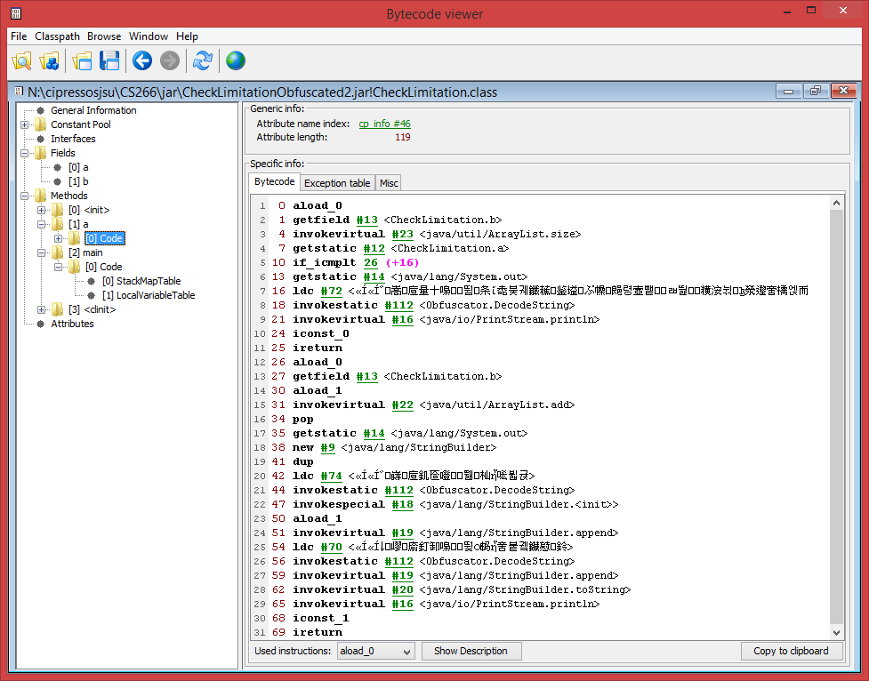
Applying Anti-Reversing Techniques to Java Bytecode Eliminating Symbolic Information

Slide 25
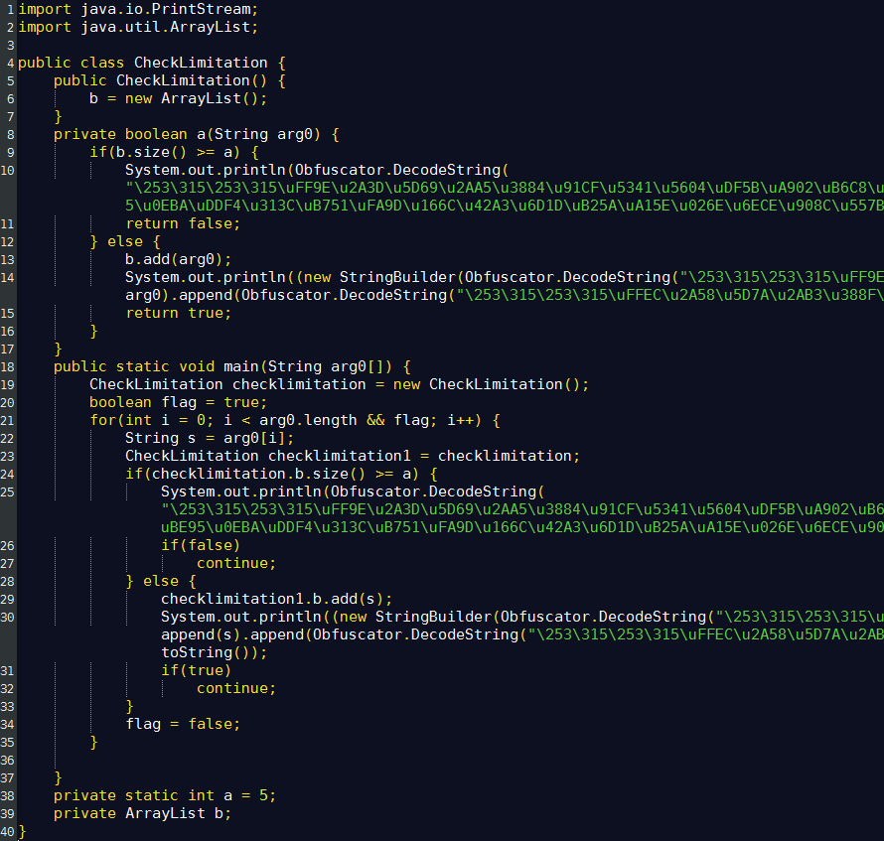
Applying Anti-Reversing Techniques to Java Bytecode Eliminating Symbolic Information

Slide 26
Applying Anti-Reversing Techniques to Java Bytecode Obfuscating The Program
One of the most popular, and fragile, techniques for preventing decompilation involves the use of opaque predicates:
By introducing false ambiguities into the control flow of a program we may trick a decompiler into traversing garbage bytes that are masquerading as logic contained in an else clause.
if ( 1 == 1 ) and if ( 1 == 2 ) are opaque predicates because the first always evaluates to true, and the second always to false.
“Branches that appear to be conditional but are really not.” [5]
The key to preventing decompilation with opaque predicates is to insert invalid instructions in the else branch of an always-true predicate or the if-body of an always false predicate.

Slide 27
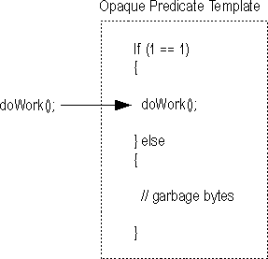
Applying Anti-Reversing Techniques to Java Bytecode Obfuscating The Program - Opaque Predicates
Since the invalid instructions will never be reached during normal operation of the program there is no impact on the program's operation.
A naïve decompiler will evaluate both possibilities of an opaque predicate and fail on attempting to decompile the invalid, unreachable “instructions”.

Slide 28
Applying Anti-Reversing Techniques to Java Bytecode Obfuscating The Program – Java Bytecode Verifier
Unfortunately, opaque predicates, often used in protecting machine code from disassembly, cannot be used with Java bytecode because of the presence of the Java Bytecode Verifier in the JVM.
The JVM verifies bytecode before execution via single-pass static analysis.
Therefore invalid instructions/garbage bytes are likely to be caught.
[31] documents the following checks made by the Java Bytecode Verifier:
Type correctness: arguments of an instruction, whether on the stack or in registers, should always be of the type expected by the instruction.
No stack overflow or underflow: instructions which remove items from the stack should not do so when the stack is empty. Also, instructions should not attempt to push items on the stack when the stack is full.

Slide 29
Applying Anti-Reversing Techniques to Java Bytecode Obfuscating The Program – Java Bytecode Verifier
Register initialization: Within a single method any use of a register must come after the initialization of that register. That is, there should be at least one store operation to that register before a load operation on that register.
Object initialization: Creation of object instances must always be followed by a call to one of the possible initialization (constructor) methods for that object before it can be used.
Access control: Method calls, field accesses, and class references must always adhere to the Java visibility policies for that method, field, or reference (e.g., private, protected, public).
Recall that bytecode targeted to run on a JVM may have been generated by something other than the accompanying Java compiler (even dynamically).
This actuality highlights the need for bytecode verification.

Slide 30
Applying Anti-Reversing Techniques to Java Bytecode Obfuscating The Program - Opaque Predicates
Opaque predicates do remain viable for machine code, though there is some evidence that good disassemblers, such as IDA Pro, do check for rudimentary opaque predicates [5].
SandMark‘s creators claim that the presence of opaque predicates in bytecode, without garbage bytes of course, makes decompilation more difficult.
SandMark implements several different algorithms for sprinkling opaque predicates throughout bytecode.
For example, the opaque branch insertion obfuscation claims to “insert jumps into a method via opaque predicates so that the control flow graph is irreducible. This inhibits decompilation.”

Slide 31
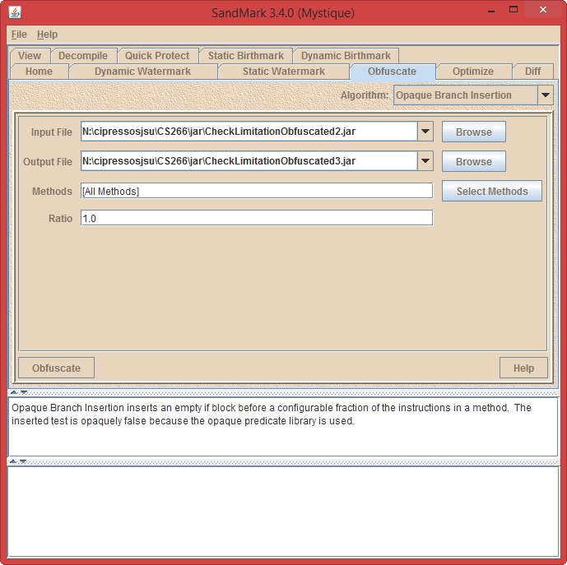
Applying Anti-Reversing Techniques to Java Bytecode Obfuscating The Program - Opaque Predicates

Slide 32
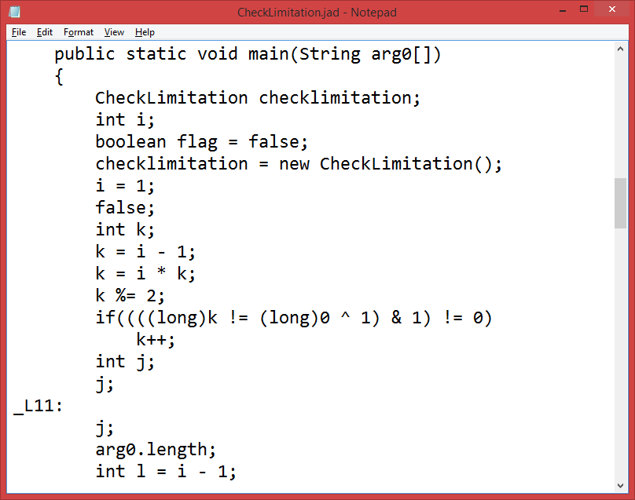
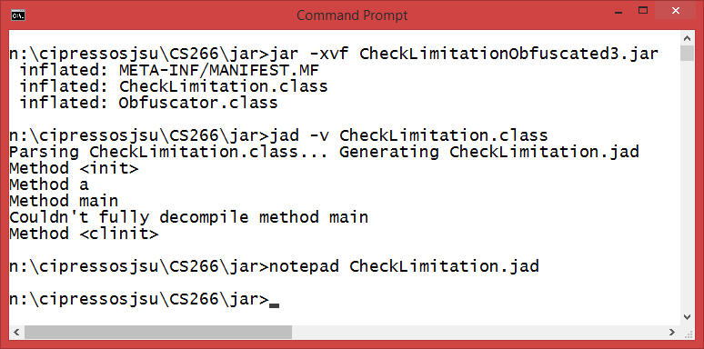
Applying Anti-Reversing Techniques to Java Bytecode Obfuscating The Program - Opaque Predicates

Slide 33
End

